Slide 1
SAR Exploration Notebooks

Slide 2
SAR Exploration Notebooks
There will be a Google Colab Notebook showing examples of data visualization and interpretation for each SAR application.
Information included in the notebooks:
Qualitative Browse Variables (How does the user know there is something in the image related to this purpose *before* they develop/implement any algorithms?)
Useful SAR Wavelength(s)
Useful Products (polarization, InSAR, coherence, etc.)
Relevant SAR Sensors
Instructions to View SAR data(RGB combo/gray scale)
Interpretation

Slide 3
GitHub Repo: https://github.jpl.nasa.gov/nspinto/rgb_fun/tree/development
15 Folders – one for each SAR Application and one Template Folder
Template Folder:
Jupyter Notebook template
In each application folder:
*.ipynb
Jupyter Notebook that reads in and creates RGB or performs other simple analyses
Includes descriptions of SAR products and interpretations
uavsar_data folder
Folder containing UAVSAR geotiffs cropped to areas of interest
Pictures folder
Pictures included in the notebooks
Tiles folder
Image tiles for the interactive maps are stored in these folders

Slide 4
# | SAR Application | UAVSAR Example | Products
1 | RGB | Creating RGB Composite and Image Stretching | HH, HV, VV
2 | Biomass | San Gabriel Mountains Station Fire | HV Ratio, Radar Vegetation Index (RVI), RGB Multi-Temporal Composite
3 | Crop Classification | Central Valley-San Joaquin Agriculture | HV Backscatter Time Series
4 | Fire | Los Angeles La Tuna Fire visualization, Thomas Fire Coherence | RGB, Coherence
5 | Fire Data | Los Angeles La Tuna Fire | HV Transects, HV Time Series
6 | Flood | Hurricane Florence | RGB, Coherence
7 | Forest Disturbance | Amazon Gold Mining, Napa Valley Deforestation, Mammoth Tree Die Off | RGB, Coherence
8 | Inundation (Wetland Delineation) | Balona Wetland, Marsh Island, Fay Slough Wildlife Area, Sierpe Mangroves | RGB
9 | Landcover (Urban Areas) | Munich, Quebec, San Diego, New Orleans | RGB
10 | Landslide | Thomas Fire’s Montecito Debris Flows | HH Coherence
11 | Oil Spill | Gulf Coast, North Sea | HH/VV Backscatter Ratio, HH and VV in dB
12 | Open Water (Surface Water Extent) | Panama Canal | RGB, HH Thresholding, HH/VV Ratio
13 | Sea Ice | Beaufort Sea | Intensity Images VV, HH
14 | Soil Moisture | Tonzi Ranch Research Site | HV/HV Ratio, VV Power
15 | Template | Jupyter Notebook Layout

Slide 5
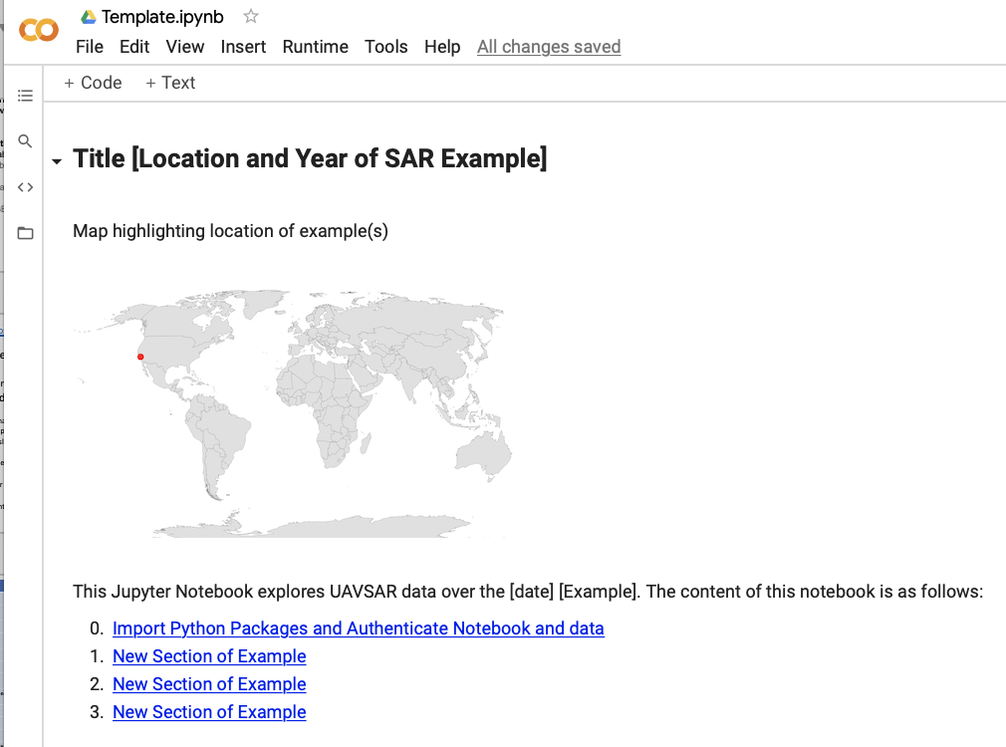
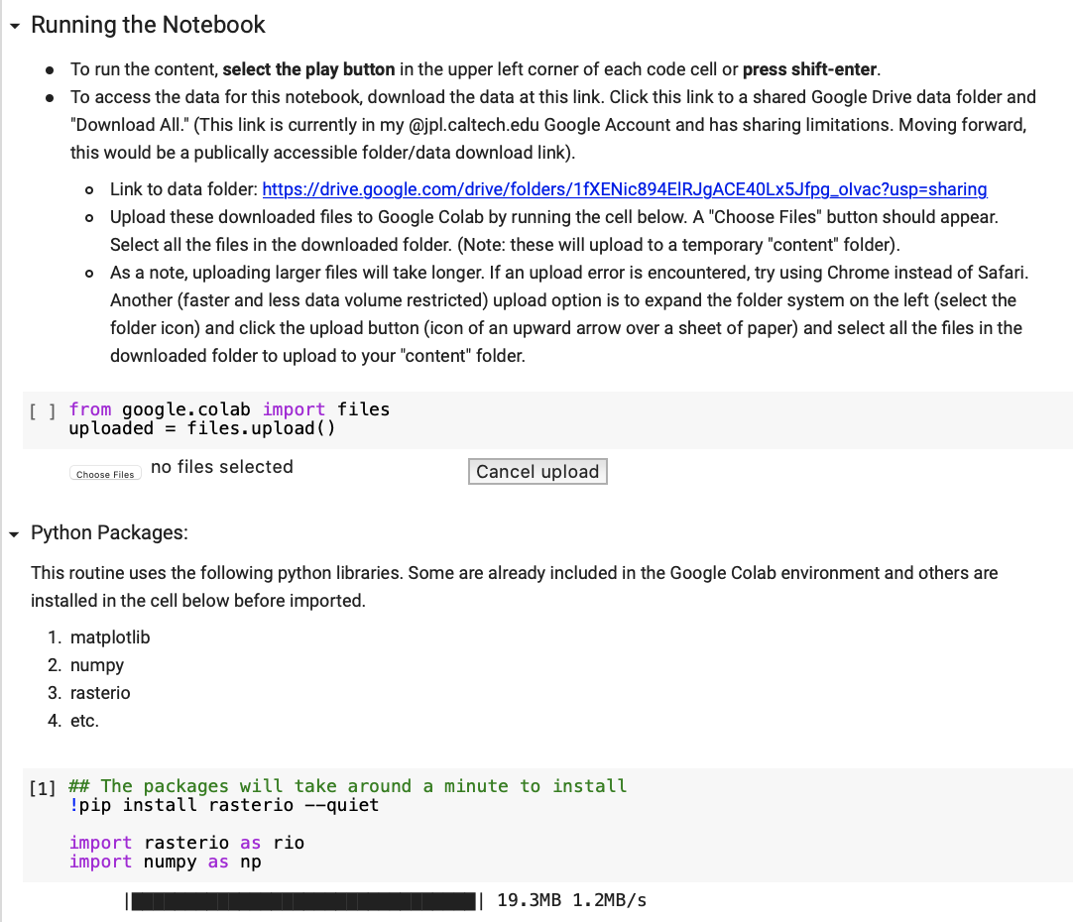
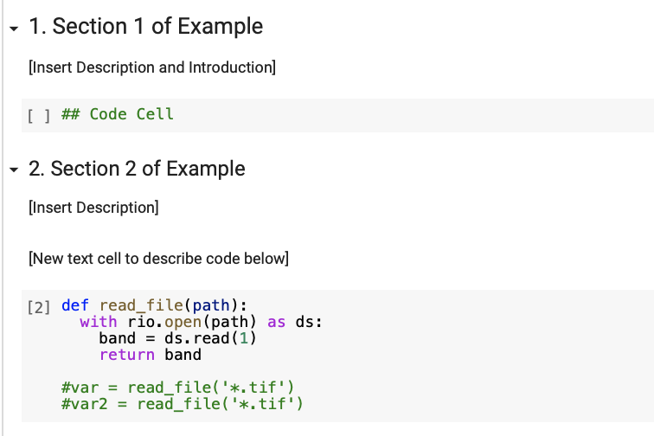
Google Colab Notebook Template
Site Map
Part 1: Title, Map of Example Location, Table of Contents
Table of Contents
Instructions on using Google Colab
Part 2: Instructions on running the notebook, upload UAVSAR files, import and install the python packages
Import UAVSAR data
Import and download necessary python packages
Part 3: Section walking through SAR examples using python code and text descriptions
Python code reading in, displaying, and exploring SAR data. Each code cell accompanied by descriptive text.

Slide 6
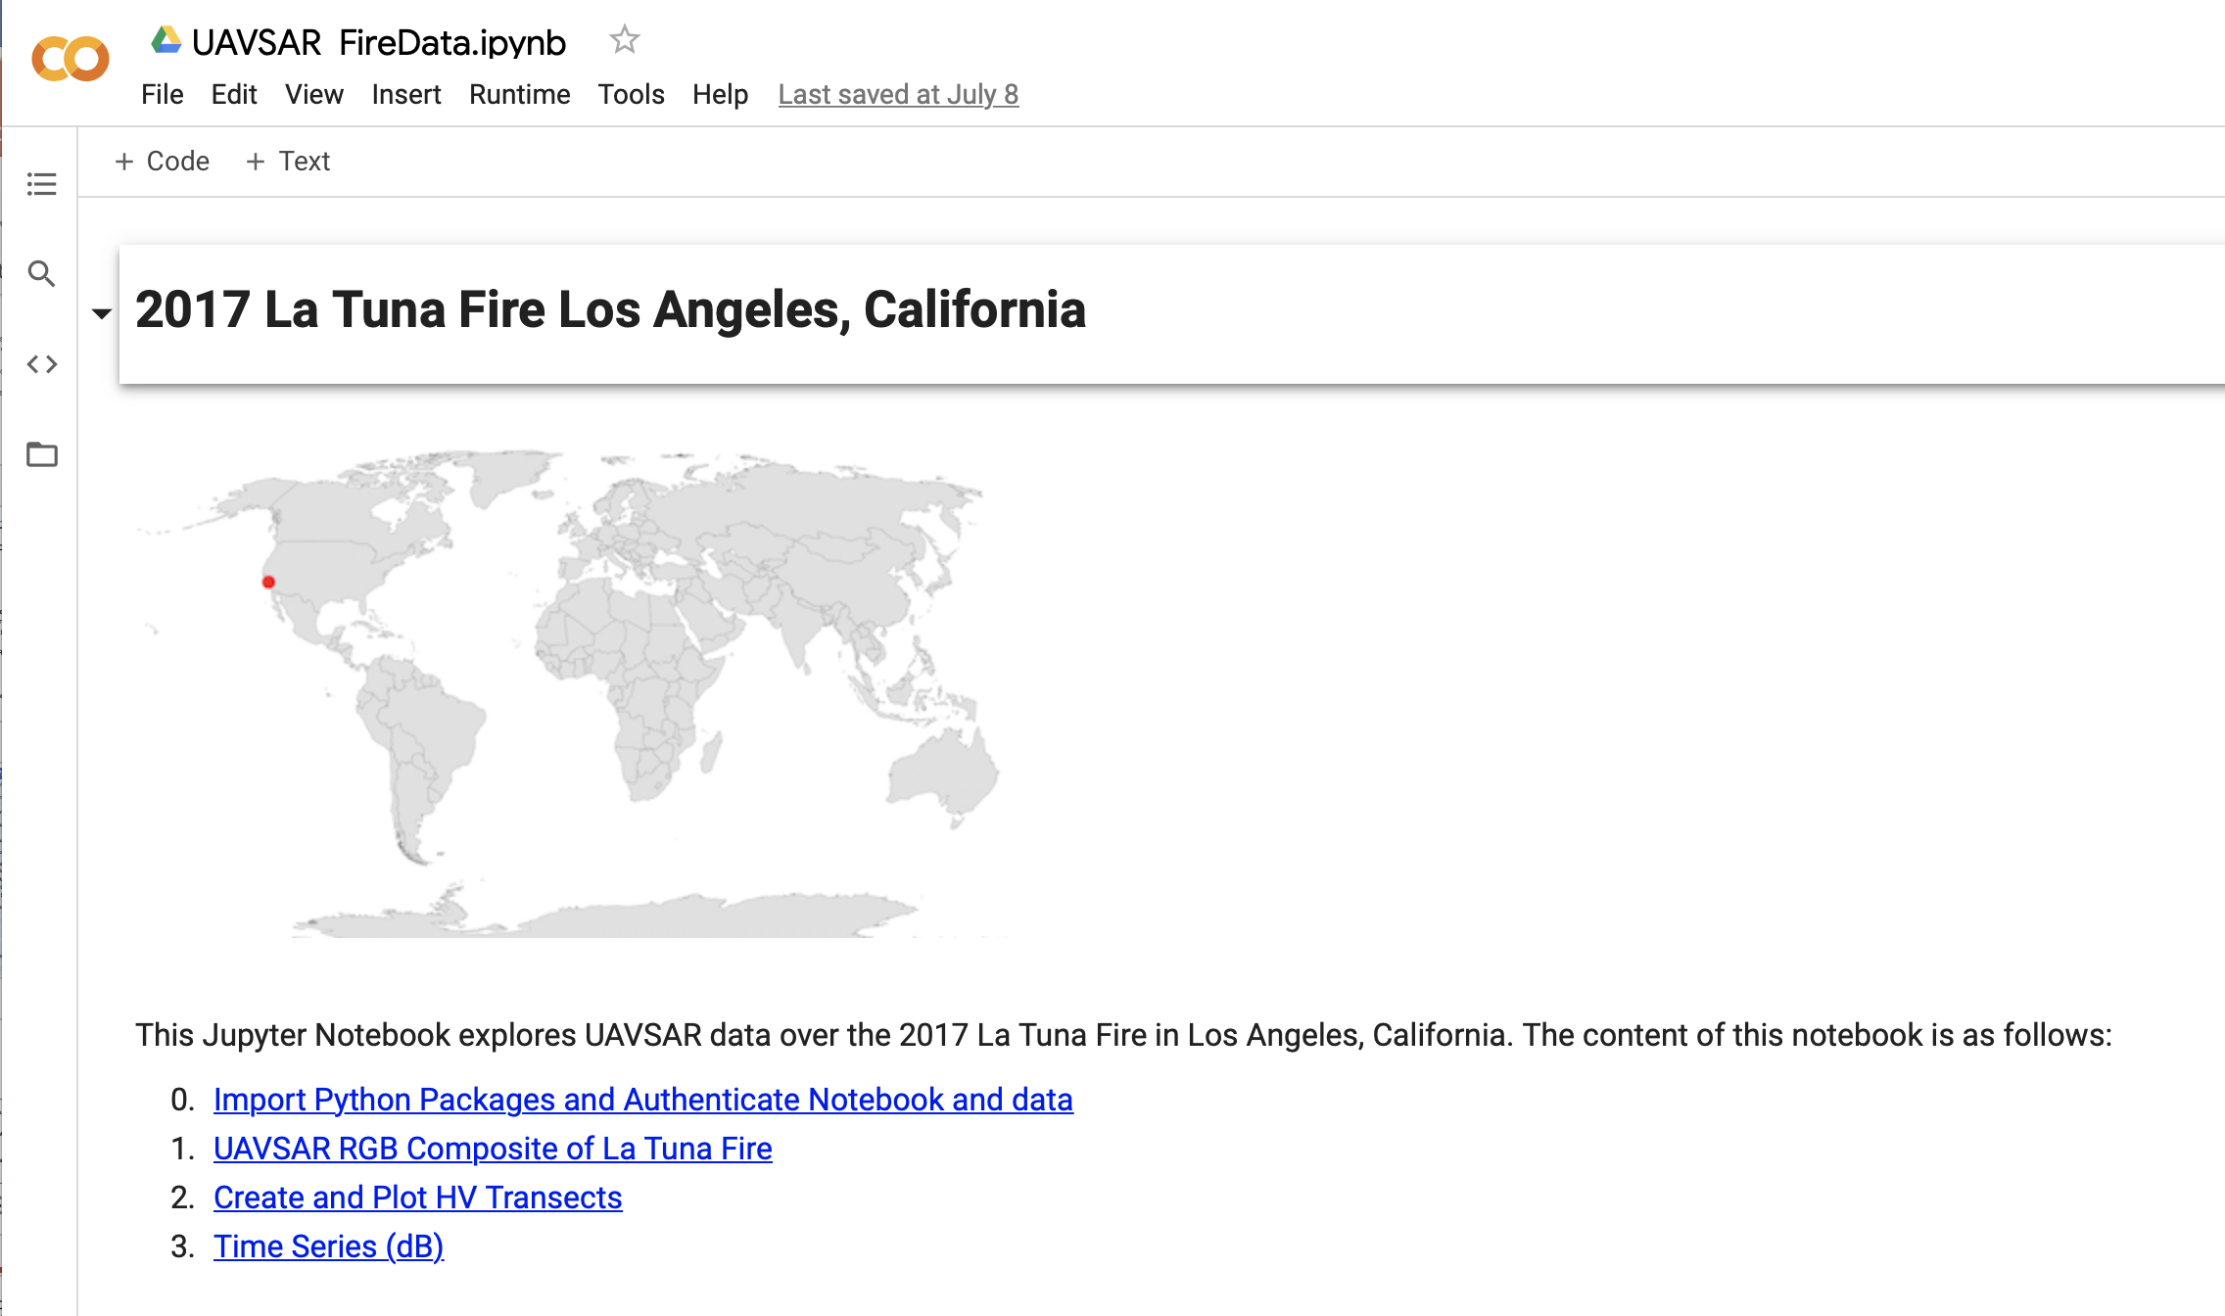
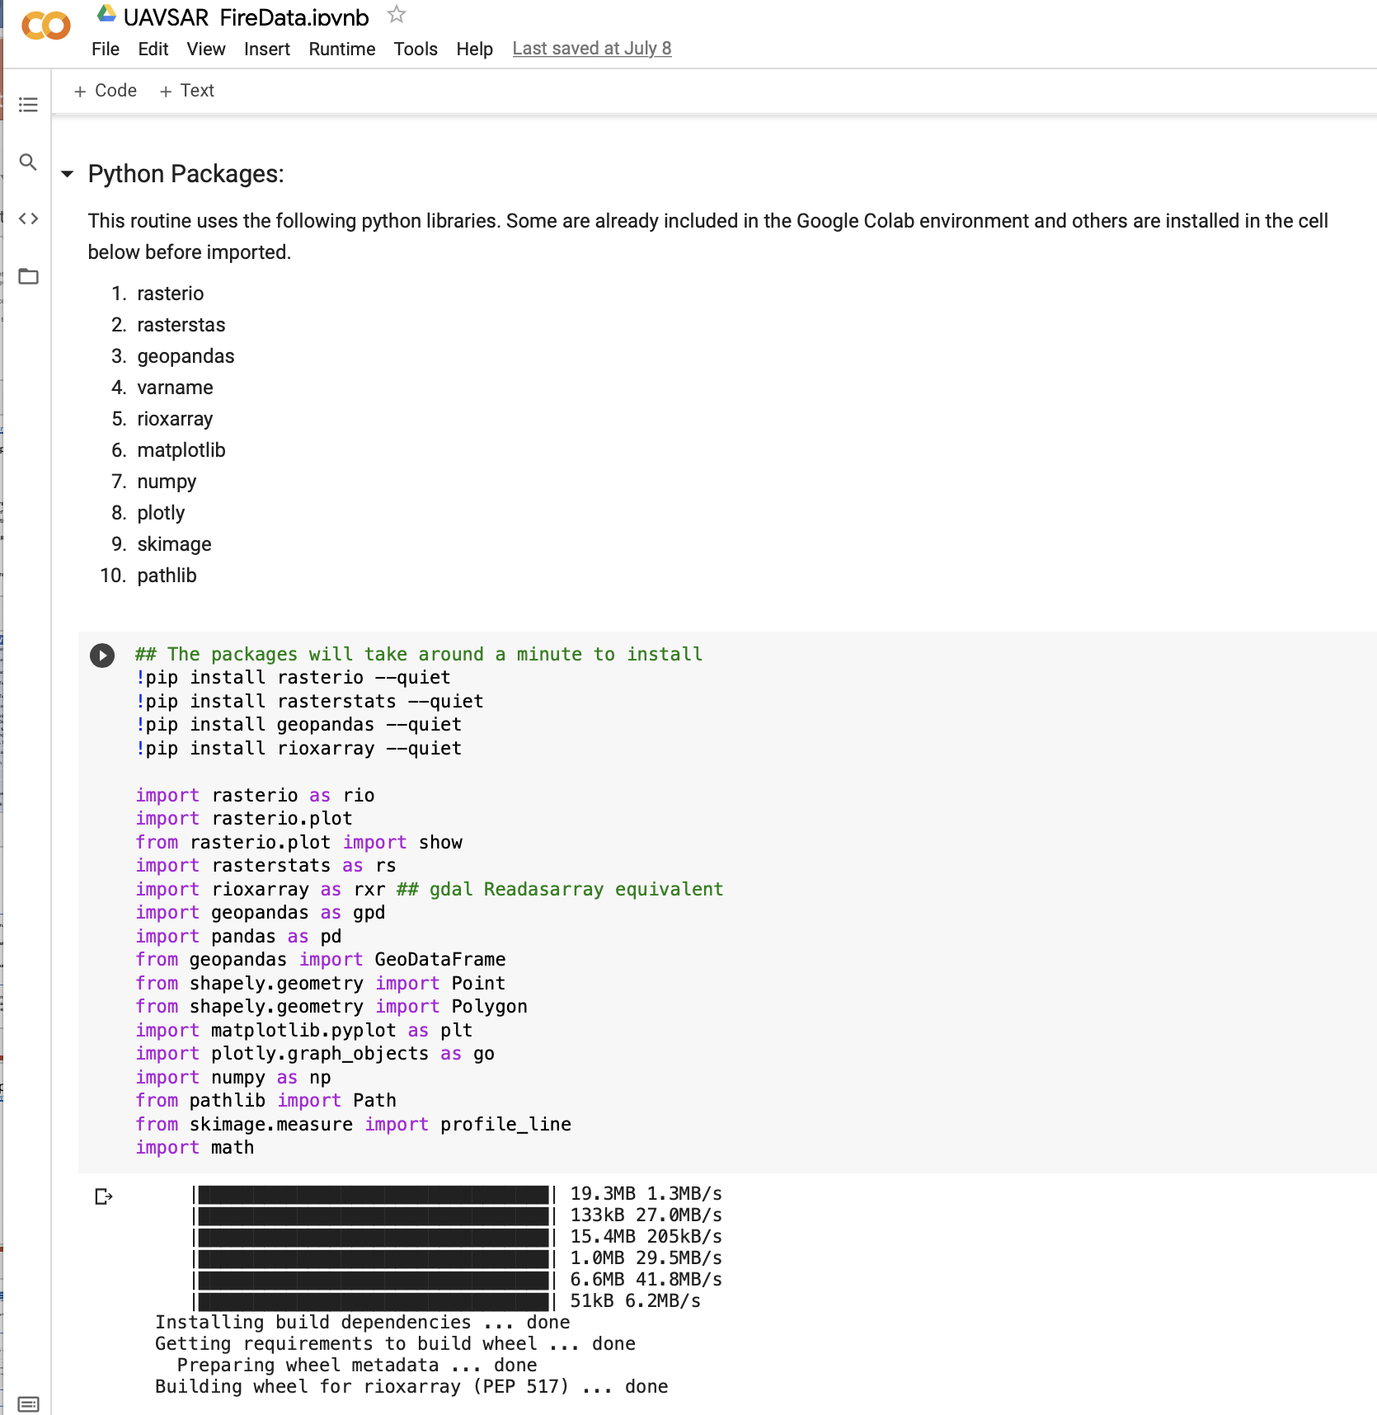
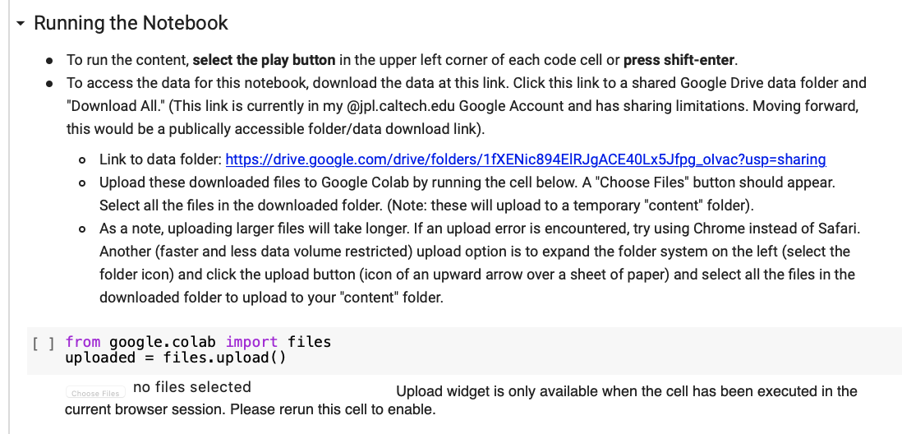
Google Colab Notebook: Fire Application Example
This is an example Google Colab Notebook exploring SAR data over the La Tuna Fire. The notebook can be accessed through a shareable link and begins with text describing the notebook’s contents and how to run the notebok/upload data. The screenshot to the right shows how to import and install new python packages to Google Colab’s environment.

Slide 7
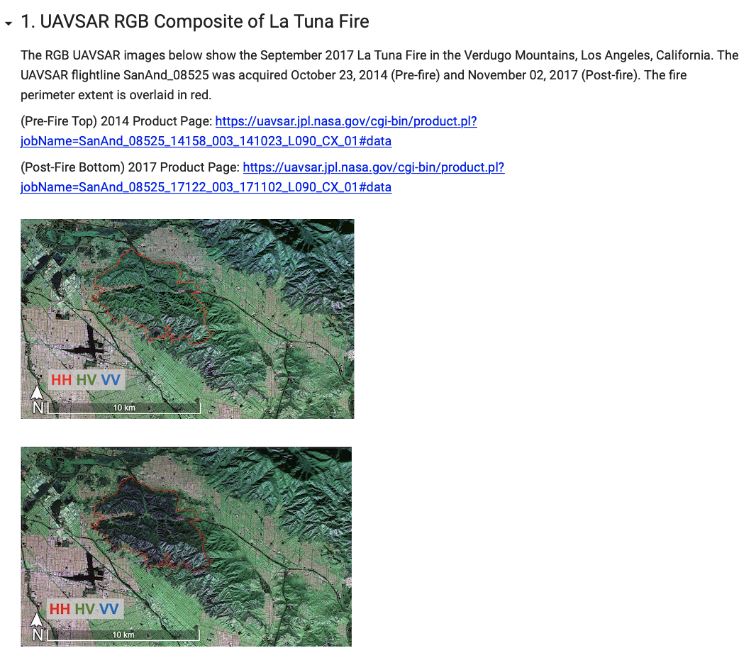
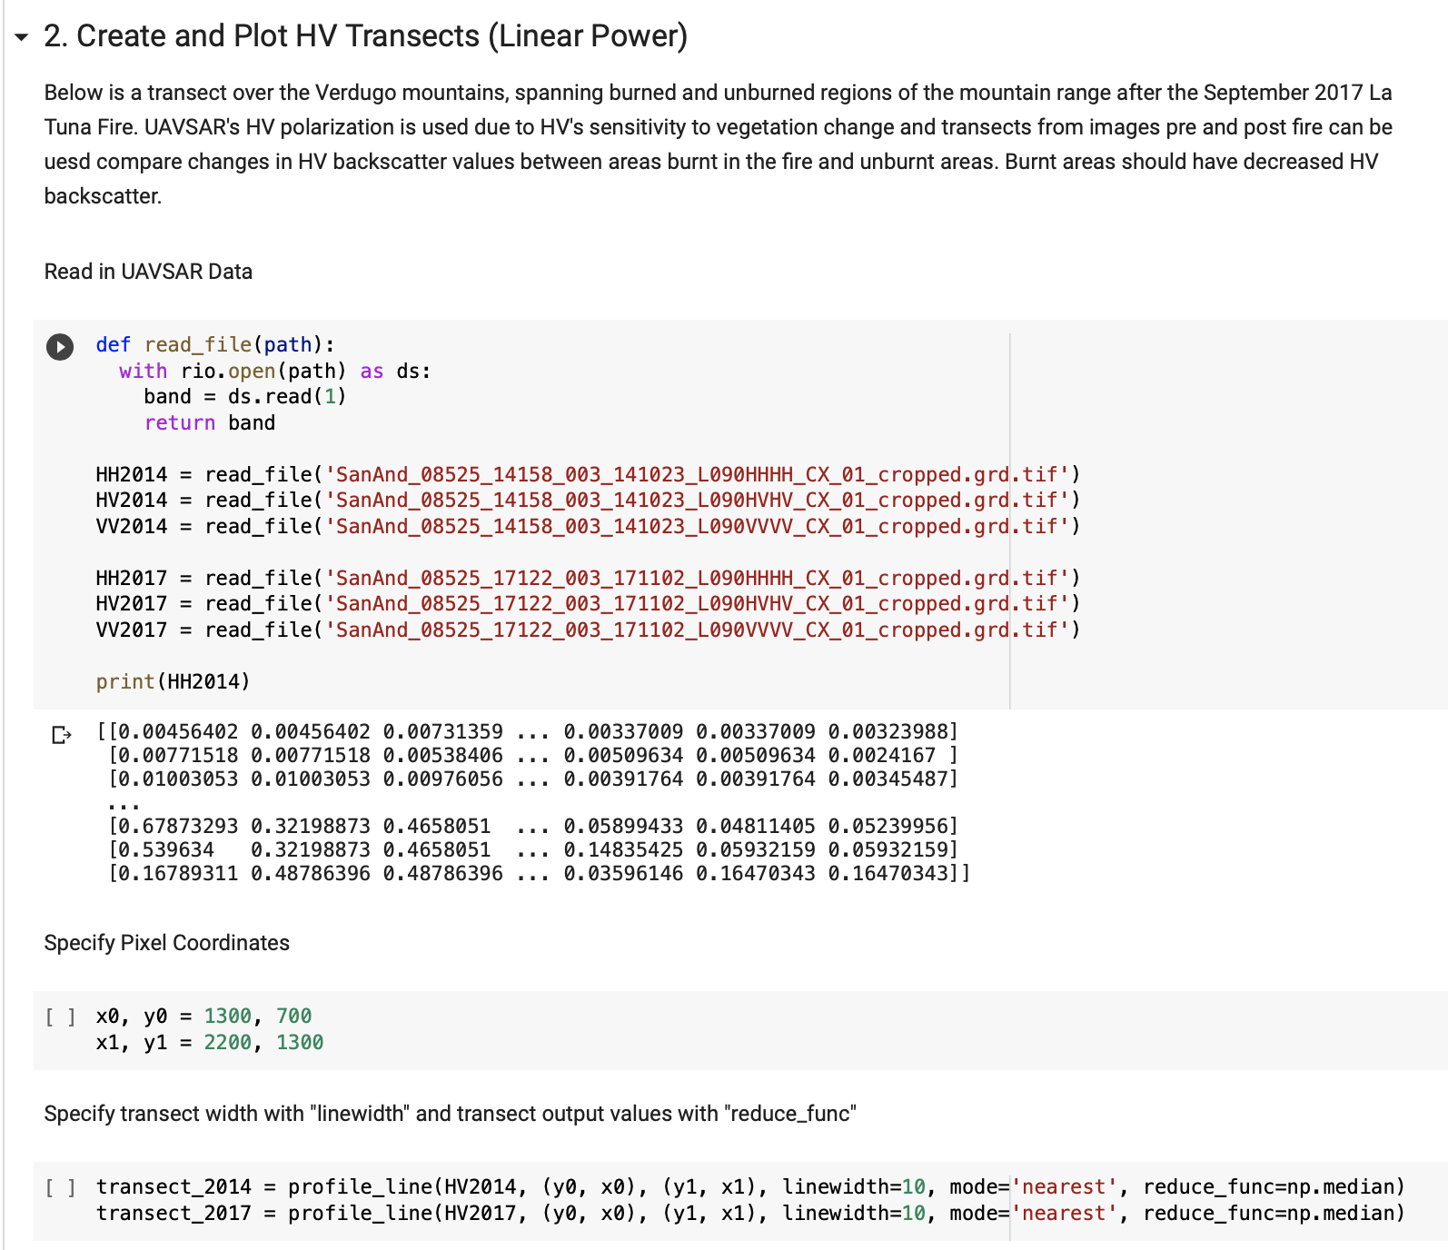
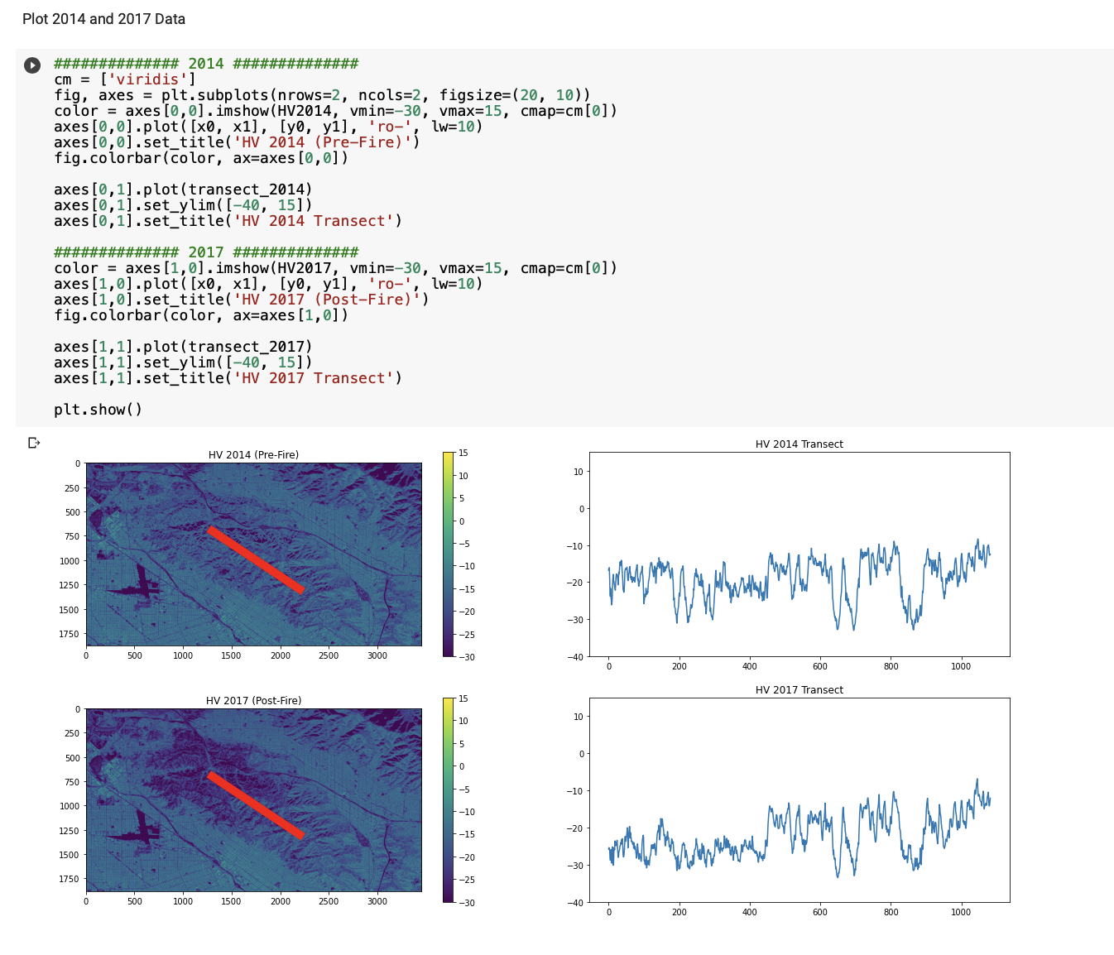
Section 1 and Section 2 of the Fire Application Notebook are below. The first section introduces the SAR example and shows the ability to embed data links and UAVSAR images. The second section reads in and plots transects of the UAVSAR data. The Google Colab environment allows for a mixture of descriptive text, python code, image display, and data plotting.

Slide 8
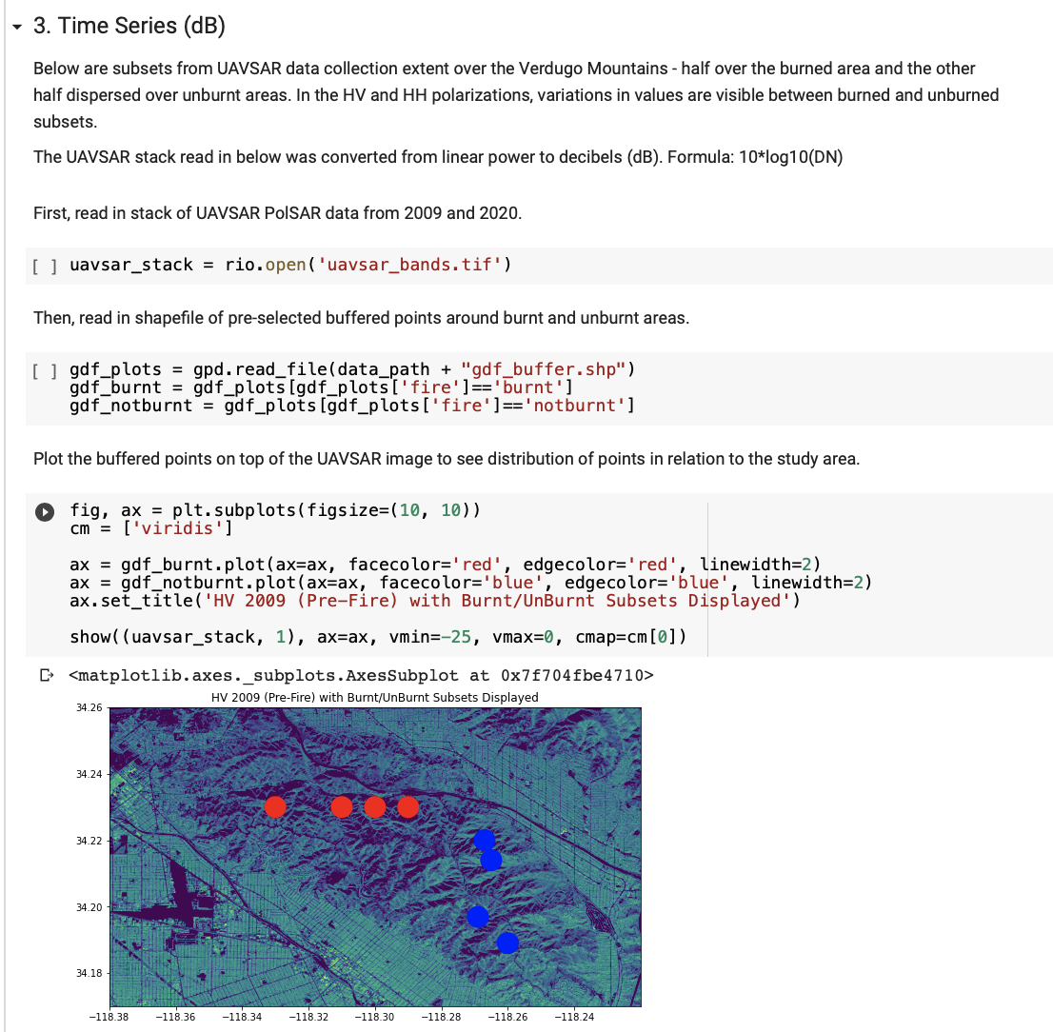
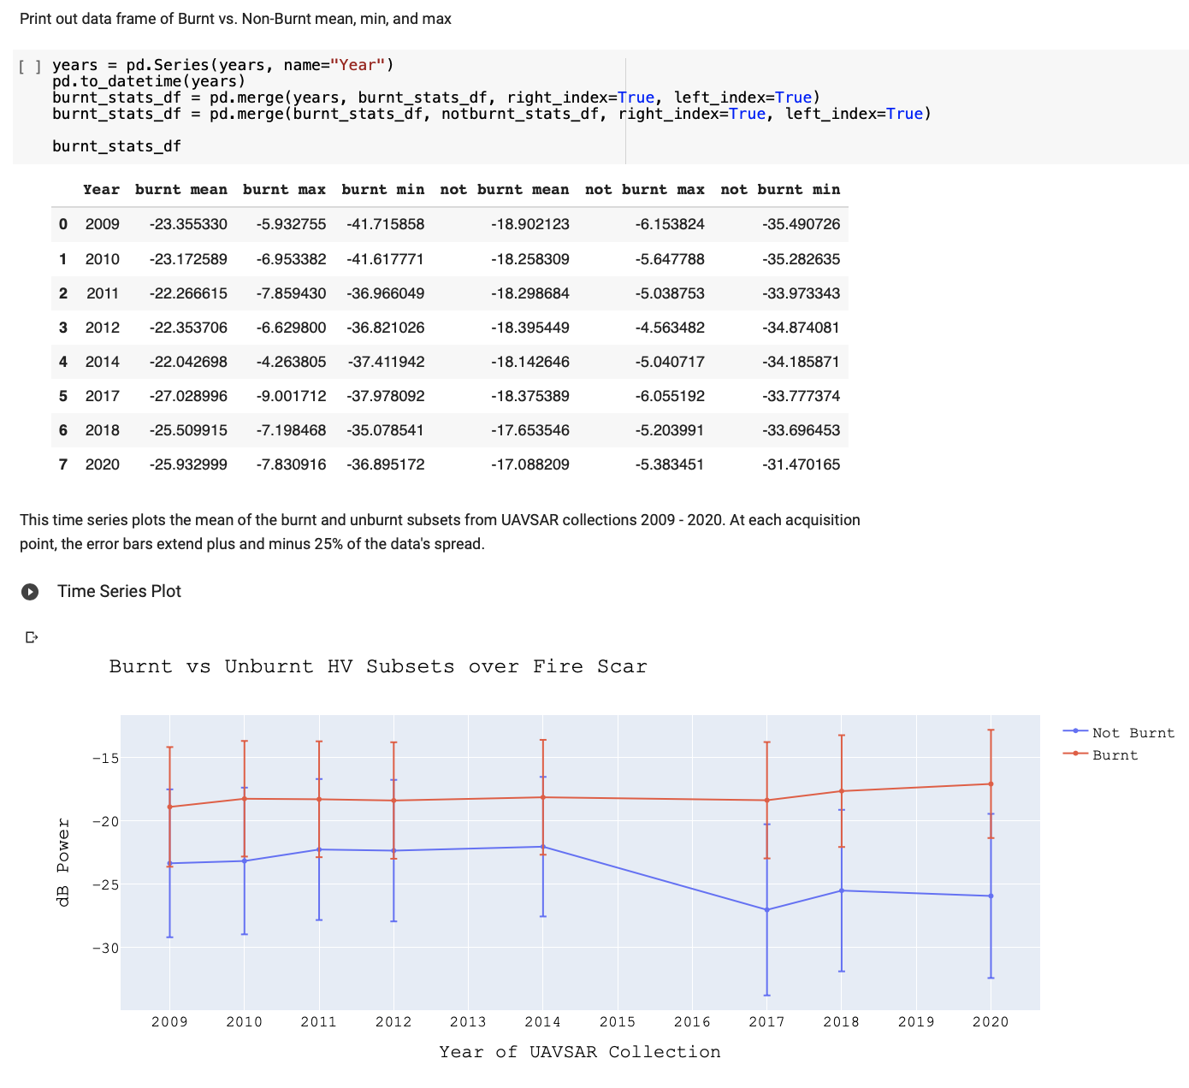
Section 3 of the Fire Application Notebook is below. This section demonstrates another way to explore SAR data over a fire. The steps below are creating a time series from UAVSAR data extracted over burnt and unburnt areas.

Slide 9
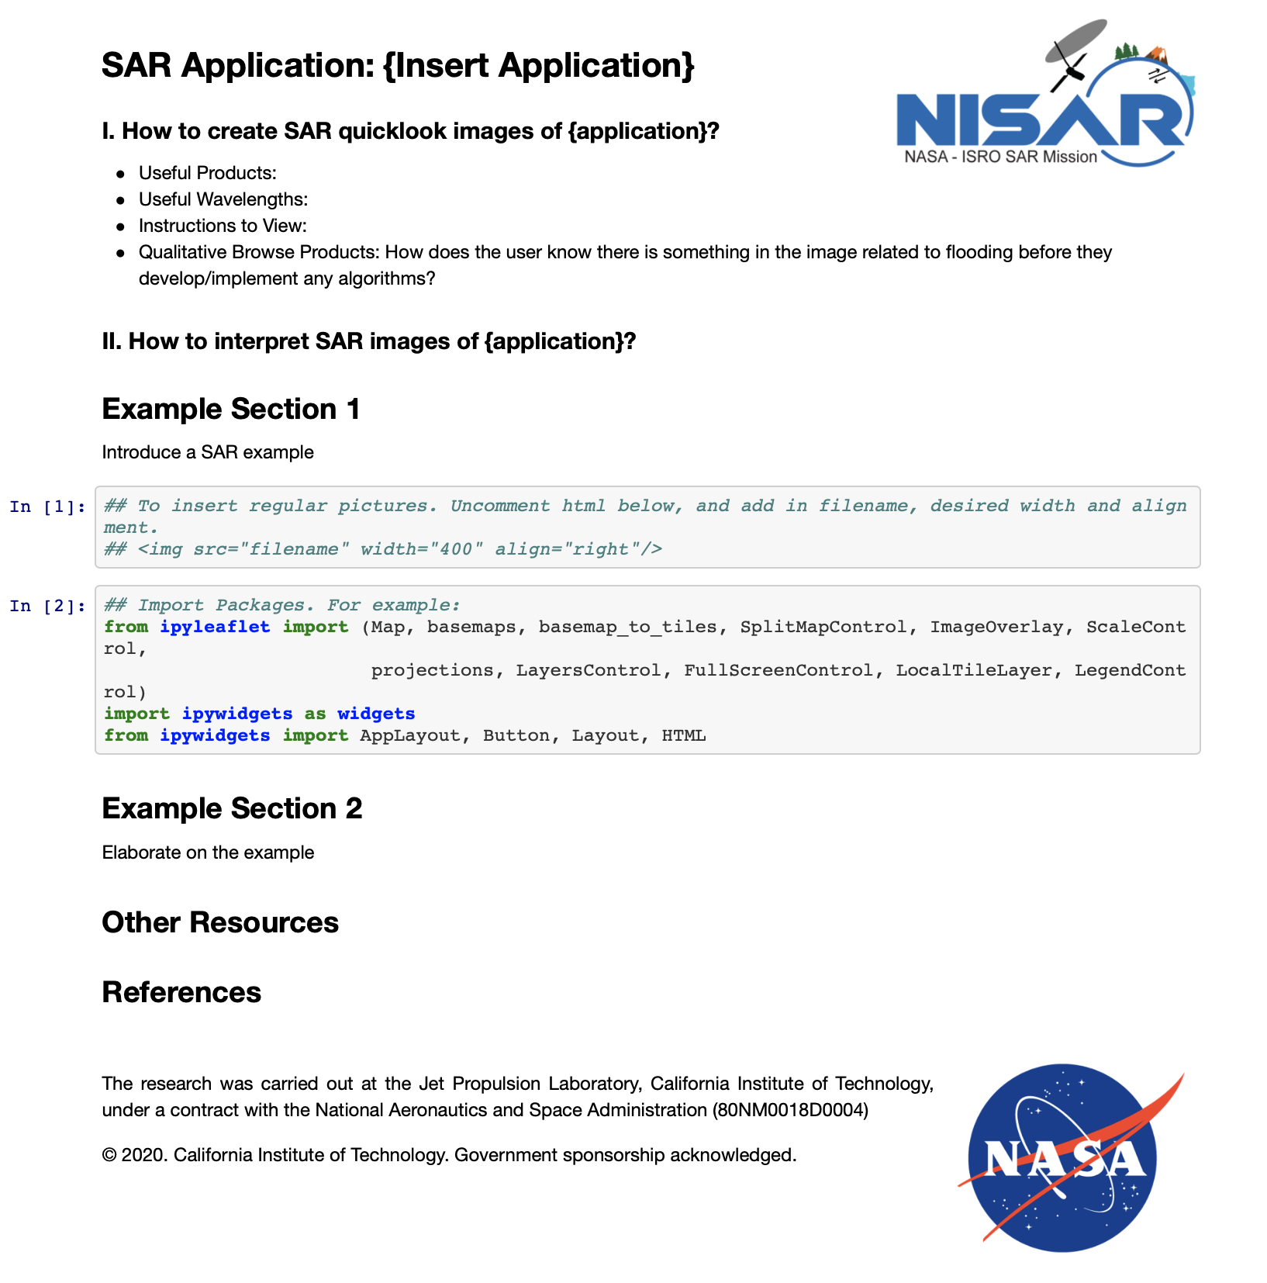
Jupyter Notebook Template Content
Section 1: Describe general processing and visualization guidelines for the application.
Section 2: Introduce a SAR example and describe how to interpret and display. Here I can include different code cells to fill in depending on desired visualization.
Visualizations could include:
interactive maps/graphs, histograms, etc. of different data products
Section 3: Provide another example or elaborate on another method/visualization
Section 4: Provide links to relevant tutorials and resources. List references.

Slide 10
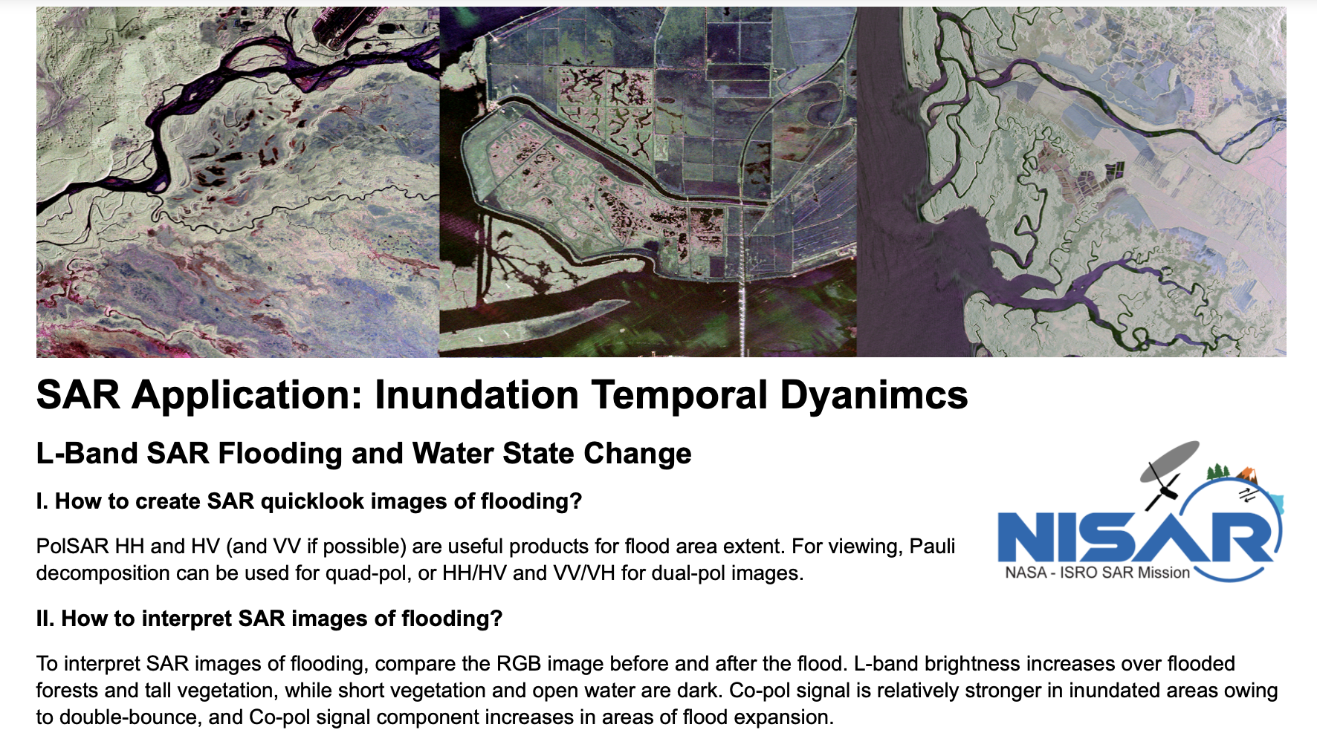
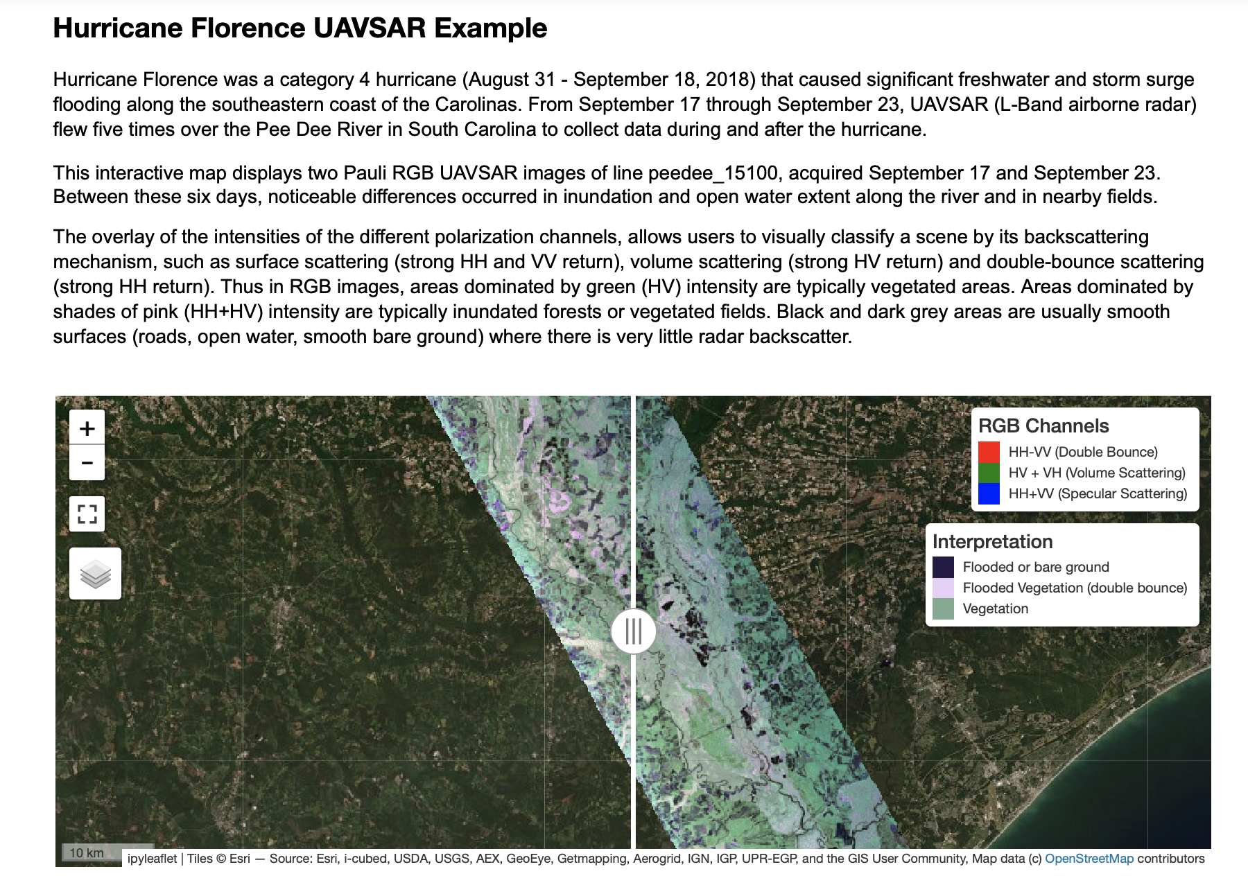
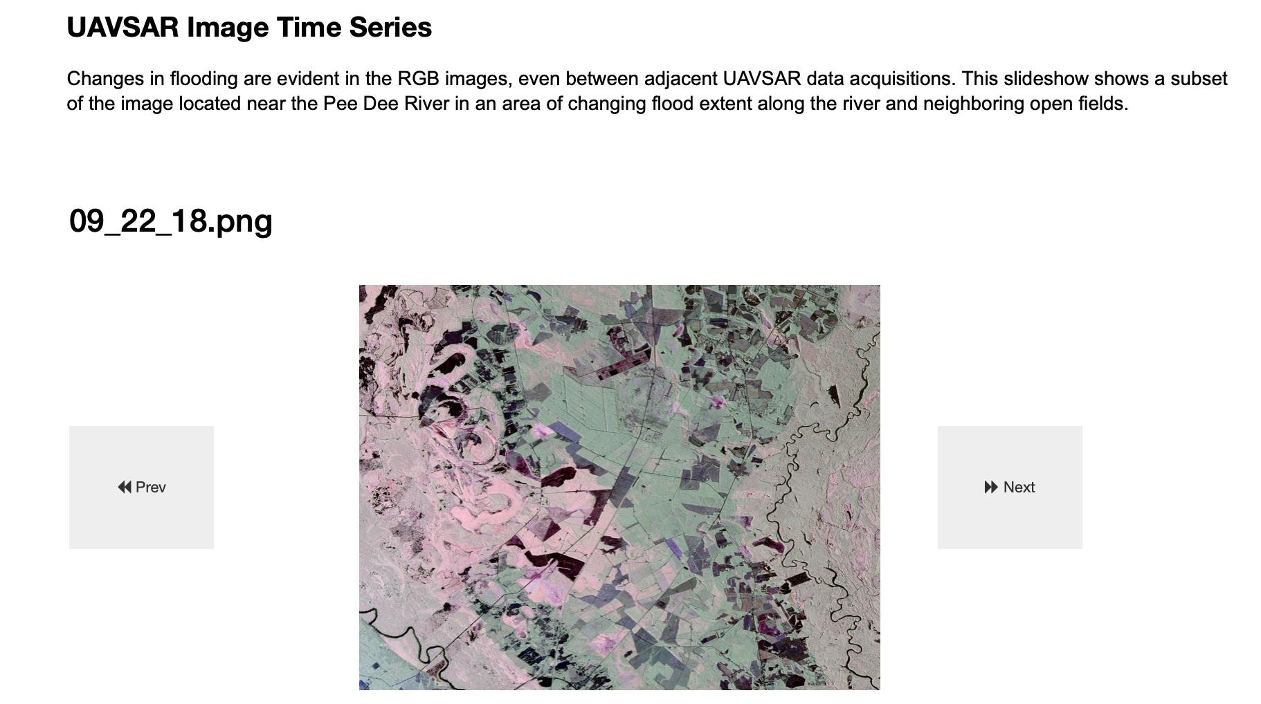
Example Notebook Layout
Section 1: Describe general processing and visualization guidelines for the application. Provide links to relevant tutorials and resources.
Section 2: Introduce a SAR example and describe how to interpret and display. This shows an interactive map of UAVSAR acquistions during and post Hurricane Florence flooding.
Section 3: Elaborate on the example. For this flooding example, we show a time series slideshow of the RGB images over a subset of the image.

